Slide 1
Lecture 4 Requirements Engineering
Dr. Hesam Chiniforooshan
se.usc.ac.ir@gmail.com

Slide 2
Agenda
Requirements Engineering: An overview
Definition of RE
Types of Requirements
Problem Domain vs. Solution Domain
Requirements Elicitation
Interviewing
Survey
Meeting
Requirements Specification
Natural Language
Use-Case Diagram
Goal-Oriented Models

Slide 3
Where is Requirements Engineering standing?
Requirements Engineering
& Business Analysis
Planning, Cost Estimation, Project Management
Test &Verification
Design Patterns &
Architecture Design
Languages, Compilers, Repositories
Methodologies & Process
Program Analysis, Comprehension, Reverse Engineering

Slide 4
What is Requirements Engineering?
Identification of the goals
(to be achieved by the envisioned system)
Operationalization
Assignment of responsibilities
Services Constraints
Humans Devices
Software
Domain analysis
Specification
Evolution
Negotiation
Assessment
Documentation
Elicitation

Slide 5
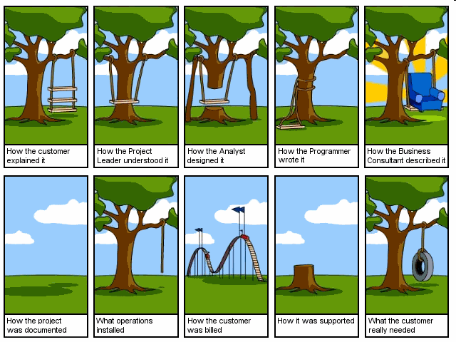
Where are Requirements Engineers standing?

Slide 6
Where are Requirements Engineers standing?

Slide 7
7

Slide 8
Importance of RE
Problems
Increased reliance on software
E.g. cars, dishwashers, cell phones, web services, …
Software now the biggest cost element for mission critical systems
E.g. Boeing 777
Wastage on failed projects
E.g. 1997 GAO report: $145 billion over 6 years on software that was never delivered
High consequences of failure
E.g. Ariane 5: $500 million payload
E.g. Intel Pentium bug: $475 million
Key factors:
Certification costs
E.g. Boeing 777: >40% of software budget spent on testing
Re-work from defect removal
E.g. Motorola: 60-80% of software budget (was) spent on re-work
Changing Requirements
E.g. California DMV system
Notes:
1) Philips estimates that the amount of software in consumer products is doubling every two years
2) Boeing 777: approximately 50% of entire development cost for the plane was spent on the avionics software
3) 1997 GAO report: Estimates that federal agencies spent $145 billion on ‘failed’ software projects over previous six years.
4) Ariane 5: Cost of the payload lost on the initial flight: $500 million. Added to this are cost of rework, delay and lost business
5) Intel Pentium bug: $475 million was written off by Intel to cover the cost of handling this bug
6) Boeing 777: Avionics software was approximately 3 million lines of code. Over 40% of the cost of developing this software was spent on testing it to FAA standards
7) Motorola estimates that 60%-80%of the development costs for software was spent on rework when the organisation did not have well defined, repeatable processes (CMM level 2-3). This was observed to drop to as low as 20% for an optimizing (CMM level 5) organization
8) California DMV - project was cancelled after 6 years, after spending $44 million. Primary cause for lack of progress was changing requirements.

Slide 9
Definition of Requirements Engineering
9
Not a phase or stage!
Requirements Engineering (RE) is a set of activities concerned with identifying and communicating the purpose of a software-intensive system, and the contexts in which it will be used. Hence, RE acts as the bridge between the real world needs of users, customers, and other constituencies affected by a software system, and the capabilities and opportunities afforded by software-intensive technologies
Communication is as important as the analysis
Designers need to know how and where the system will be used
Quality means fitness-for-purpose. Cannot say anything about quality unless you understand the purpose
Requirements are partly about what is needed…
…and partly about
what is possible
Need to identify all the stakeholders - not just the customer and user

Slide 10
Types of Requirements
System requirements:
Functional and Non-functional Requirements
Qualities
Functionalities

Slide 11
Types of Requirements
Business Goals
reputation
Maintenance cost
implementation cost
time to market
understandable
effort
Design Requirements
maintainable
reusable
easy to learn
testable
easy to use
Qualities
secure
expandable
self-recovery
safe to use
confidential
accountable
available
fast
Functionalities
What the system does?

Slide 12
Problem Domain vs. Solution Domain
Two basic principles:
It is useful to separate the problem the solution
And to document a problem statement separately from any design solutions
This separation can never be achieved fully in practice
Because design changes the world, and therefore changes the original problem

Slide 13
Separate the problem from the solution
A separate problem description is useful:
Most obvious problem might not the right one to solve
Problem statement can be discussed with stakeholders
Problem statement can be used to evaluate design choices
Problem statement is a source of good test cases
Still need to check:
Solution correctly solves the stated problem
Problem statement corresponds to the needs of the stakeholders
Problem Situation
Problem
Statement
Validation
Verification
Correspondence
Correctness
Implementation
Statement
System

Slide 14
But design changes the world…
Problem Situation
change
System
abstract
model of world
implementation
statement
problem
statement

Slide 15
Intertwining of problems and solutions
Independent
Implementation Dependence
Dependent
General
Path of exploration
Level
of
Detail
Problem
Statement
Implementation
Statement
Detailed

Slide 16
A problem to describe…
E.g. “prevent unauthorized access to CS machines”
Machine Domain
Application Domain
students
encryption algorithms
intruders
T-cards
password files
sysadmins
passwords
password
allocation
process
memory management
signed forms
usernames
cache contents
typing at
keyboard
stickies with
passwords on
secure sockets
things the machine
cannot observe
shared
things
things private
to the machine

Slide 17
But we can also move the boundaries…
E.g. Elevator control system:
Machine Domain
Application Domain
people waiting
Elevator call buttons
Scheduling algorithm
people in the elevator
Floor request buttons
people wanting to go to a particular floor
button lights
Current floor indicators
Control program
Motor on/off
Elevator motors
Door open/close
Safety rules
We can shift things around:
E.g. Add some sensors to detect when people are waiting
This changes the nature of the problem to be solved

Slide 18
What are requirements?
Application Domain
Machine Domain
C - computers
D - domain properties
s - specification
R - requirements
P - programs
Domain Properties:
things in the application domain that are true whether or not we ever build the proposed system
Requirements:
things in the application domain that we wish to be made true by delivering the proposed system
Many of which will involve phenomena to which the machine has no access
A Specification:
is a description of the behaviours that the program must have in order to meet the requirements
Can only be written in terms of shared phenomena!

Slide 19
Fitness for purpose?
Example:
Requirement R:
“Only CS Students shall have access to CS Labs”
Domain Properties D:
T-Cards open the CS lab doors
Doors are lucked by default.
Specification S:
The t-card of CS students must be the only authorization means to open the CS labs’ door.
Verification: S, D R
Two correctness (verification) criteria:
The Program running on a particular Computer satisfies the Specification
The Specification, in the context of the given domain properties, satisfies the requirements
Two completeness (validation) criteria:
We discovered all the important requirements
We discovered all the relevant domain properties

Slide 20
Another Example
Requirement R:
“The database shall only be accessible by authorized personnel”
Domain Properties D:
Authorized personnel have passwords
Passwords are never shared with non-authorized personnel
Specification S:
Access to the database shall only be granted after the user types an authorized password
S + D entail R
But what if the domain assumptions are wrong?

Slide 21
Setting the Boundaries
How will the software interact with the world?
Systems engineer decides what application domain phenomena are shared
E.g. the four variable model:
Decide the boundaries by designing the input/output devices
Uses I/O data items as proxies for the monitored and controlled variables
System
Environ- ment
Input devices
software
Output devices
Environ- ment
Monitored
input
output
Controlled
Variables
data
data
Variables
S - Specification of software in terms of inputs & outputs
R - Requirements: what control actions the system must take in which circumstances.
D - Domain Properties that constrain how the environment can behave

Slide 22
How many points were there in the star that was used as a focus slide for this seminar?

Slide 24
24
Agenda
Requirements Engineering: An overview
Definition of RE
Types of RE
Problem Domain vs. Solution Domain
Requirements Elicitation
Interviewing
Survey
Meeting
Requirements Specification
Natural Language
Use-Case Diagram
Goal-Oriented Models

Slide 25
Requirements Elicitation Techniques
Traditional techniques
Introspection
Reading existing documents
Analyzing hard data
Interviews
Open-ended
Structured
Surveys / Questionnaires
Meetings
Collaborative techniques
Group techniques
Focus Groups
Brainstorming
JAD/RAD workshops
Prototyping
Participatory Design
Cognitive techniques
Task analysis
Protocol analysis
Knowledge Acquisition Techniques
Card Sorting
Laddering
Contextual approaches
Ethnographic techniques
Participant Observation
Enthnomethodology
Discourse Analysis
Conversation Analysis
Speech Act Analysis
Sociotechnical Methods
Soft Systems Analysis

Slide 26
Requirements Elicitation Techniques

Slide 27
Interviews
Types:
Structured - agenda of fairly open questions
Open-ended - no pre-set agenda
Advantages
Rich collection of information
Good for uncovering opinions, feelings, goals, as well as hard facts
Can probe in depth, & adapt followup questions to what the person tells you
Disadvantages
Large amount of qualitative data can be hard to analyze
Hard to compare different respondents
Interviewing is a difficult skill to master
Watch for
Unanswerable questions (“how do you tie your shoelaces?”)
Tacit knowledge (and post-hoc rationalizations)
Removal from context
Interviewer’s attitude may cause bias (e.g. variable attentiveness)
Source: Adapted from Goguen and Linde, 1993, p154.

Slide 28
Interviewing Tips
Starting off…
Begin the interview with an safe topic to set people at ease
e.g. the weather, the score in last night’s hockey game
e.g. comment on an object on the person’s desk: “My,… what a beautiful photograph! Did you take that?”
Ask if you can record the interview
but put tape recorder in front of person
say that they can turn it off any time.
Ask easy questions first
perhaps personal information
e.g. “How long have you worked in your present position?”
Follow up interesting leads
E.g. if you hear something that indicates your plan of action may be wrong,
e.g.,“Could we pursue what you just said a little further?”
Ask open-ended questions last
e.g. “Is there anything else you would like to add?”

Slide 29
Surveys and Questionnaires
Advantages
Can quickly collect info from large numbers of people
Can be administered remotely
Can collect attitudes, beliefs, characteristics
Disadvantages
Simplistic (presupposed) categories provide very little context
No room for users to convey their real needs
Watch for:
Bias in sample selection
Bias in self-selecting respondents
Small sample size (lack of statistical significance)
Open ended questions (very hard to analyze!)
Leading questions (“have you stopped beating your wife?”)
Appropriation
Ambiguous questions (i.e. not everyone is answering the same question)
Questionnaires MUST be prototyped and tested!
Source: Adapted from Goguen and Linde, 1993, p154.

Slide 30
Meetings
Used for summarization and feedback
E.g. meet with stakeholders towards the end of each stage:
to discuss the results of the information gathering stage
to conclude on a set of requirements
to agree on a design etc.
Use the meeting to confirm what has been learned, talk about findings
Meetings are an important managerial tool
Used to move a system development project forward.
Need to determine objectives for the meeting:
E.g. presentation, problem solving, conflict resolution, progress analysis, gathering and merging of facts, training, planning,...
Plan the meeting carefully:
Schedule the meeting and arrange for facilities
Prepare an agenda and distribute it well in advance
Keep track of time and agenda during the meeting
Follow up with a written summary to be distributed to meeting participants
Special rules apply for formal presentations, walkthroughs, brainstorming, etc.

Slide 31
Group Elicitation Techniques
Types:
Focus Groups
Brainstorming
Advantages
More natural interaction between people than formal interview
Can measure reaction to stimulus materials (e.g. mock-ups, storyboards, etc)
Disadvantages
May create unnatural groups (uncomfortable for participants)
Danger of Groupthink
May only provide superficial responses to technical questions
Requires a highly trained facilitator
Watch for
Sample Bias
Dominance and Submission

Slide 32
32
Agenda
Requirements Engineering: An overview
Definition of RE
Types of RE
Problem Domain vs. Solution Domain
Requirements Elicitation
Interviewing
Survey
Meeting
Requirements Specification
Natural Language
Use-Case Diagram
Goal-Oriented Models

Slide 33
Requirements Specification Techniques
Natural Language
Requirements Modeling
Basics of modelling
Notations and their uses
Formality and Expressiveness
Abstraction and Decomposition
Model management and viewpoints
Types of Analysis
Enterprises Modeling
Business rules and organizational structures
Goals, tasks and responsibilities
Soft Systems analysis
Modeling Functional Req.
Structured Modeling
Use Case Modeling
Entities and Relationships
Classes and Objects
Domain Ontology
Behavioral Modeling
Activities and Interactions
States and Transitions
Concurrency
Modeling non-Functional Req.
Goal Oriented Modeling
Taxonomies of NFRs
Performance
Usability
Safety
Security
Reliability
Maintainability

Slide 34
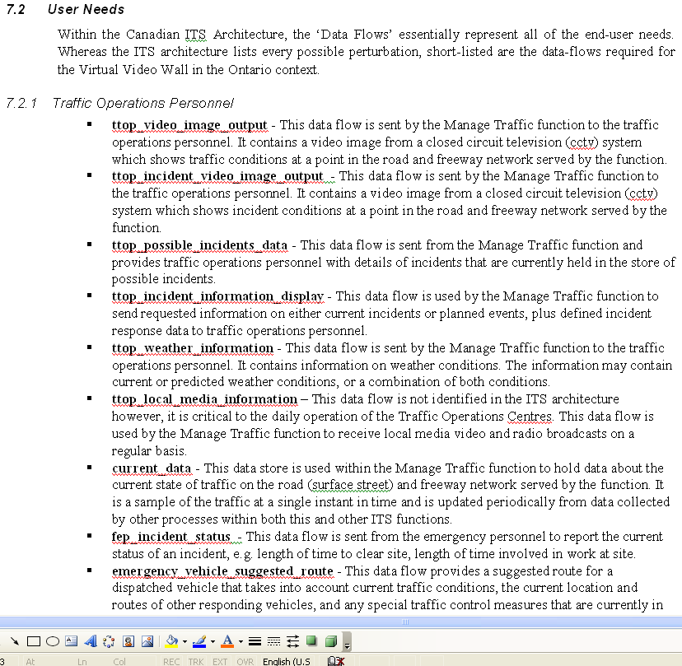
Natural Language
34

Slide 35
Problems with NL specification
Ambiguity
The readers and writers of the requirement must interpret the same words in the same way. NL is naturally ambiguous so this is very difficult.
Over-flexibility
The same thing may be said in a number of different ways in the specification.
Lack of modularisation
NL structures are inadequate to structure system requirements.

Slide 36
Alternatives to NL specification

Slide 38
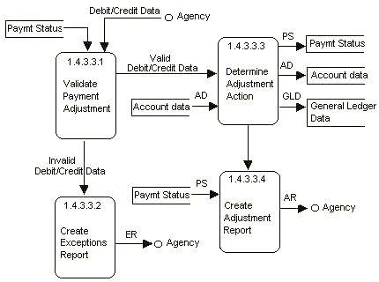
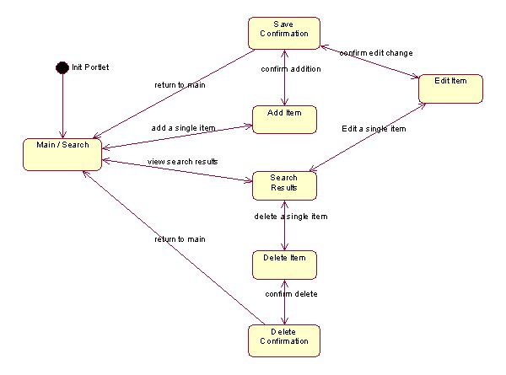
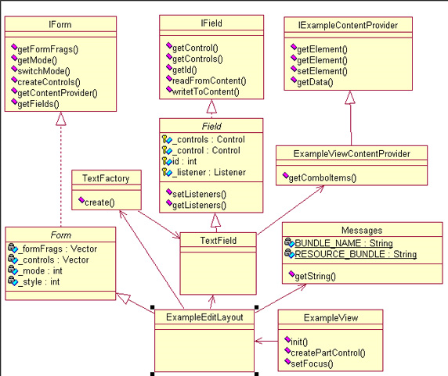
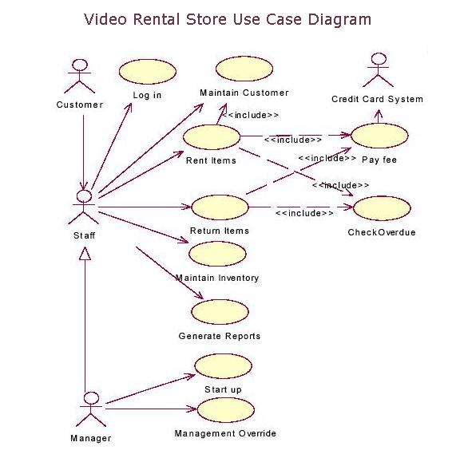

Slide 39
Use Case Diagrams
In Requirements Engineering, we aim to
Share our vision and view of the system
Bridge the gap between the domain problem and the software
Communicate
Define the capabilities of the software
Use Case Diagram is a modeling tool in Requirements Engineering

Slide 40
Use Case Diagrams
A use case is a flow of events in the system, including interaction with actors
It is initiated by an actor
Each use case has a name
Each use case has a termination condition

Slide 41
How to find use cases?
Select a narrow vertical slice of the system
Discuss it in detail with the user
Select a horizontal slice to define the scope of the system.
Discuss the scope with the user
What are the main functionalities?
What users do or want to do?

Slide 42
Use Case Associations
A use case association is a relationship between use cases:
Include
A use case uses another use case (“functional decomposition”)
Extends
A use case extends another use case
Generalization
An abstract use case has different specializations

Slide 43
<<Include>>: Functional Decomposition
Problem:
A function in the original problem statement is too complex to be solvable immediately
Solution:
Describe the function as the aggregation of a set of simpler functions. The associated use case is decomposed into smaller use cases
ManageIncident
<<include>>
<<include>>
<<include>>
HandleIncident
CloseIncident
CreateIncident

Slide 44
<<Include>>: Reuse of Existing Functionality
Problem:
There are already existing functions. How can we reuse them?
Solution:
The include association from a use case A to a use case B indicates that an instance of the use case A performs all the behavior described in the use case B
A
<<include>>
B
OpenIncident
Base Use
Case
ViewMap
<<include>>
Supplier
Use Case
AllocateResources

Slide 45
<Extend>> Association for Use Cases
Problem:
The functionality in the original problem statement needs to be extended.
Solution:
An extend association from a use case A to a use case B indicates that use case B is an extension of use case A
B
Help
A
FieldOfficer
<<extend>>
f
ReportEmergency

Slide 46
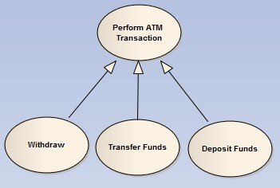
Generalization in use cases
Problem:
You have common behavior among use cases and want to factor this out.
Solution:
The generalization association among use cases factors out common behavior. The child use cases inherit the behavior and meaning of the parent use case and add or override some behavior.
Parent
Case
Child
Use Case

Slide 48
Use Case Modeling
How to incorporate, model, communicate, and analyze the Non-Functional Requirements in between?
Let’s do an exercise
Develop use case model

Slide 49
Why we should ask why?
Customers usually do not have an exact set of requirements.
Customers usually express their requirements in terms of the system requirements.
Customers have a list of problems that assume a software solution can solve.
A software system can make a value if addresses the right problem correctly.

Slide 50

Why we should ask why?
Once a zoo owner asked an engineer to develop him a high tech door lock.
Why such an advanced lock was needed?
Zoo

Slide 51
Why Goal-Oriented Requirements Engineering (GORE)?
Most systems today are socio-technical, e.g.,
E-business; E-learning; E-health; E-government
Energy, environment, transportation
Complex relationships among stakeholders
Know what they want
E.g., security, privacy, trust, profitability, market positioning, strategic alliances, intellectual property, …
Help them achieve what they want
Understanding “why”, not just “what”
Strategic actors. Each one asks:
What do I want?
How can I achieve what I want?
Who do I depend on to achieve what I want?

Slide 52
Goal Models
Typical system models capture “how”, “what”, and “when”.
Intentional models capture “why”, the motivations behind high-level system design using goals.
Emphasis on non-functional requirements – softgoals

Slide 53
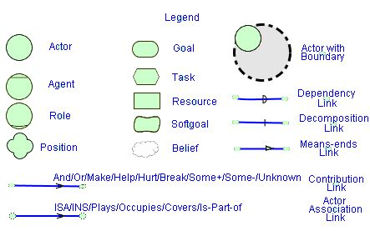
i* Notation Legend

Slide 54
Goal Model Evaluation
Making use of models beyond their creation – Analysis:
Answer interesting domain questions
Decide between high-level design alternatives

Slide 55
Agenda
Requirements Engineering: An overview
Goal-Oriented Requirements Engineering
Why we should ask why?
Modeling goals: the i* notation
Requirements Trade-off Analysis with a Goal-Oriented approach: My research
Issue: Lack of numbers
Making hard decisions

Slide 56
NFR Trade-offs
Security
Performance
Privacy
Low Costs
Subjective trade-offs.
Different stakeholders with different security and privacy expectations.
Imprecise, uncertain, or ill-defined quantitative data.
Ethical issues with making trade-offs.
Notes:
Software requirements that come from different stakeholders may have some conflicts, satisfaction of some requirements may result in denial of some other. Security is a requirements that prevent certain actions and usually does not take root from stakeholder interest, but comes from the risk or attacks and vulnerabilities. In this sense, security is about trade-offs. Specially, security is about feeling based not on probabilities and mathematical calculations but psychological reactions. We need to deal with subjective trade-offs, and different security and privacy expectations of different stakeholders. Data collected about many of the non functional requirements, specially security is imprecise, qualitative, ill-defines, and uncertain. And finally, there some are some ethical issues involved in quantifying these data, such as assigning financial costs to human loss or privacy violation.

Slide 57
Source
Slides based on the presentation of RE to Software Engineering students of University of Toronto, by Dr. Golnaz Elahi

